Slide 1
Solving the Rubik’s cube with ai
- Team 9
Satish Kumar Jonna
Trinath Vandavasi Guru

Slide 2


Problem Statement
Developing an AI agent capable of solving a 2×2 Rubik’s Cube using Reinforcement Learning.
Implementing a Deep Q-Network (DQN) that learns optimal moves through interaction with the environment.
Design a reward function that guides the agent toward achieving a fully solved cube.
Analyze training performance to evaluate the algorithm’s ability to learn effective solving strategies.

Slide 3
Tools & Environment
Python
PyTorch (for Deep Q-Learning)
Custom Cube Environment (rubiks.py)
Neural Network Implementation (ai_learner.py)
Techniques
State Representation: One-hot encoding of cube configuration
Action Space: 12 possible face rotations
Learning Algorithm: Deep Q-Learning (DQN)
Experience Replay + Epsilon-Greedy Action Selection
Reward Function Measuring Cube Correctness

Slide 4
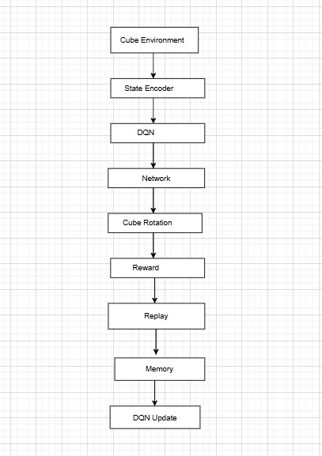
Rubik’s Cube AI Workflow:

Slide 5
Cube Environment (rubiks.py)
Key Features:
- 6 × n × n NumPy representation
- Clockwise & counterclockwise rotations
- Middle layer rotations
- Scrambling function
- One-hot encoded state output

Slide 6
Deep Q learning Algorithm (ai_learner.py)
Rubicks.py – Cube Environment
Creates the cube, performs rotations, scrambles, and outputs updated state.
State Encoder
Converts cube faces into a one-hot vector for DQN input.
DQN Model (ailearner.py)
Neural network predicts Q-values for all possible actions.
Action Selector (ε-greedy)
Chooses moves by balancing exploration and exploitation.
Environment Step
Action → cube rotates → produces next state and reward.
Replay Memory
Stores transitions (s, a, r, s’) for stable RL training.
Training Engine (ailearner.py)
Samples batches, computes loss, updates DQN weights.
Evaluation Module
Shows best cube, solved attempts, and learning progress.

Slide 7
Reward Function
Reward Components:
- +3 for each correct corner
- +2 for correct edges
- +1 for inner squares
- +2 bonus for fully correct face
Purpose: Guide agent toward solved cube.

Slide 8
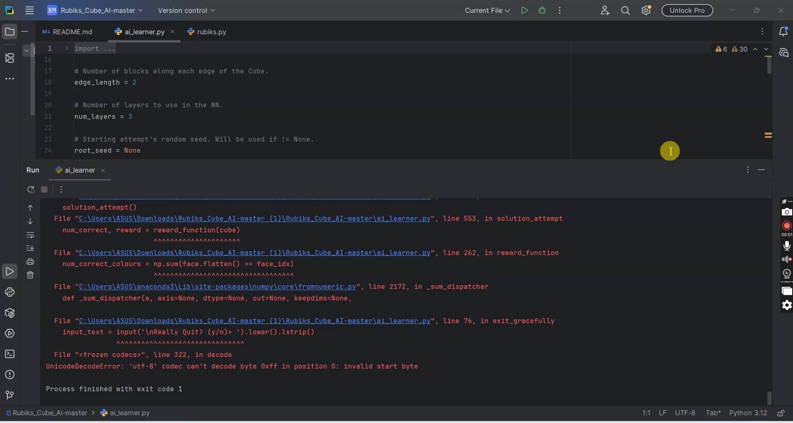
Demo of AI learners.py

Slide 9
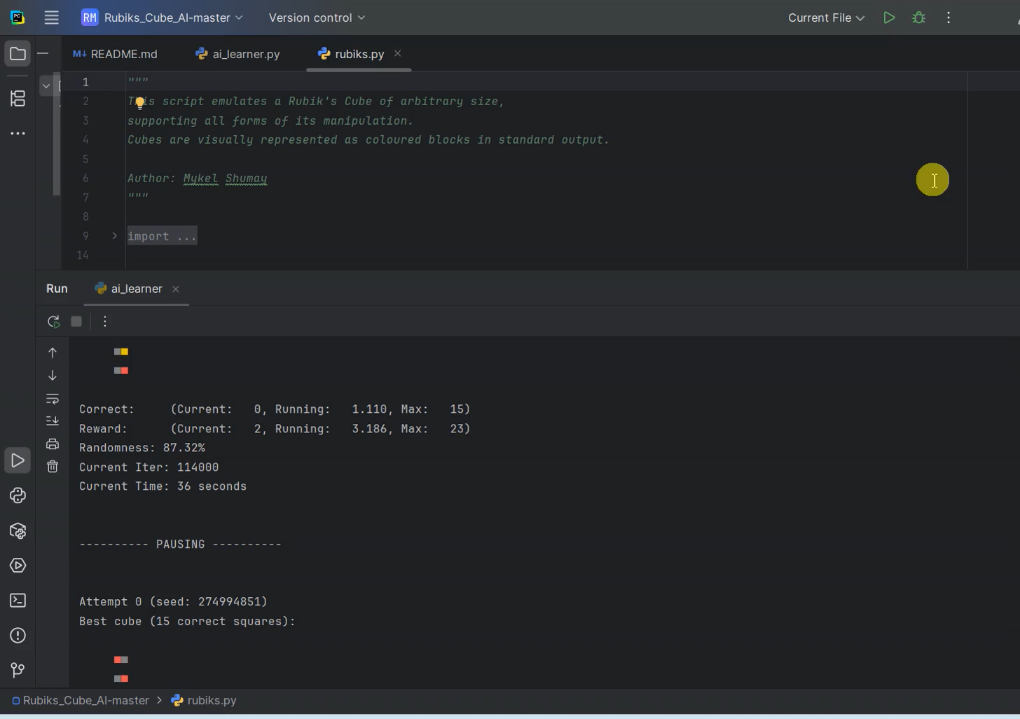
Demo of Rubiks.py

Slide 10
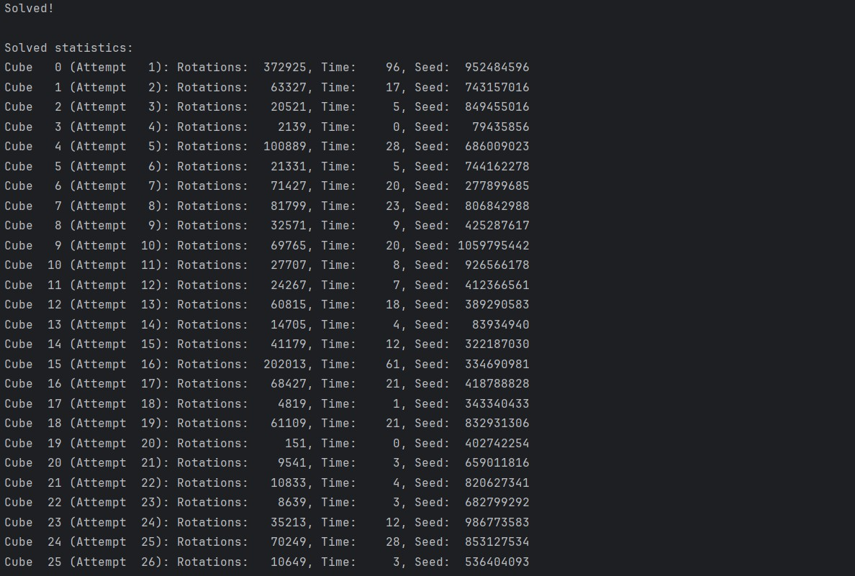
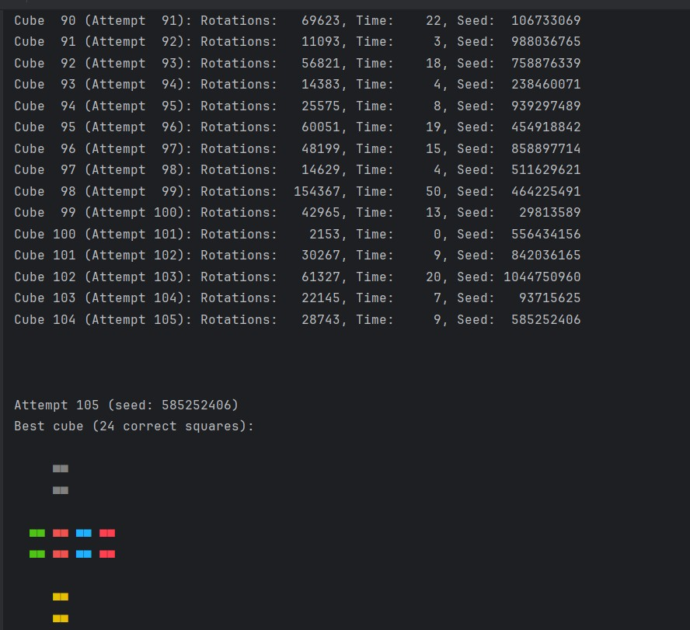
Results of AI learners.py

Slide 11
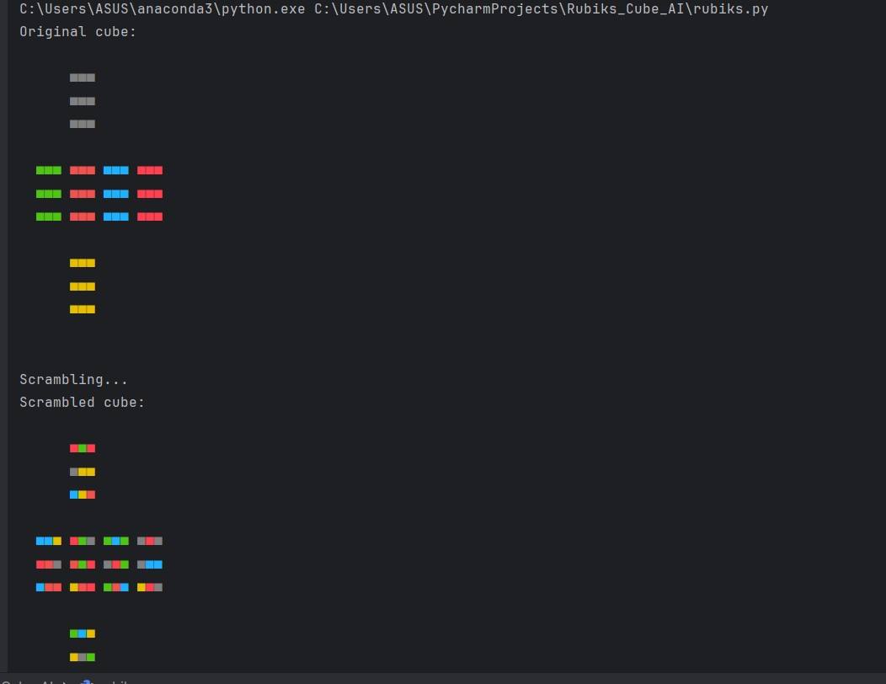
Results of Rubics.py

Slide 12
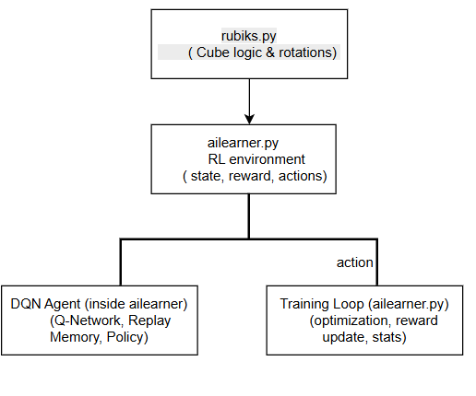
TRAINING AND DEVELOPMENT
Rubiks.py : Cube representation
- Creates the Rubik’s Cube, handles face rotations, edge movements, scrambling, and provides the visual output of the cube.
Ailearner.py : RL agent + training loop
Contains: – DQN model – Replay Memory – Action selection (ε-greedy) – Reward calculation – Optimization step – Solving attempts & statistics

Slide 13
Challenges
- Sparse rewards slow convergence
- Hard to learn long solving sequences
- Sensitive to hyperparameters
- 3×3 cube is exponentially harder

Slide 14
Future Work
- Implement Double-DQN / Dueling-DQN
- Better reward shaping
- CNN-based visual encoding
- Imitation learning with example solutions

Slide 15
Summary
Reinforcement Learning + DQN used to solve 2×2 Rubik’s Cube.
System improves cube correctness significantly.
Mid-term results show strong learning progress.
Final goal: stable, reproducible solutions.

Slide 16

THANK YOU

